Slide 1

01
FUNGI
KIT
Wiring Guide

Slide 2


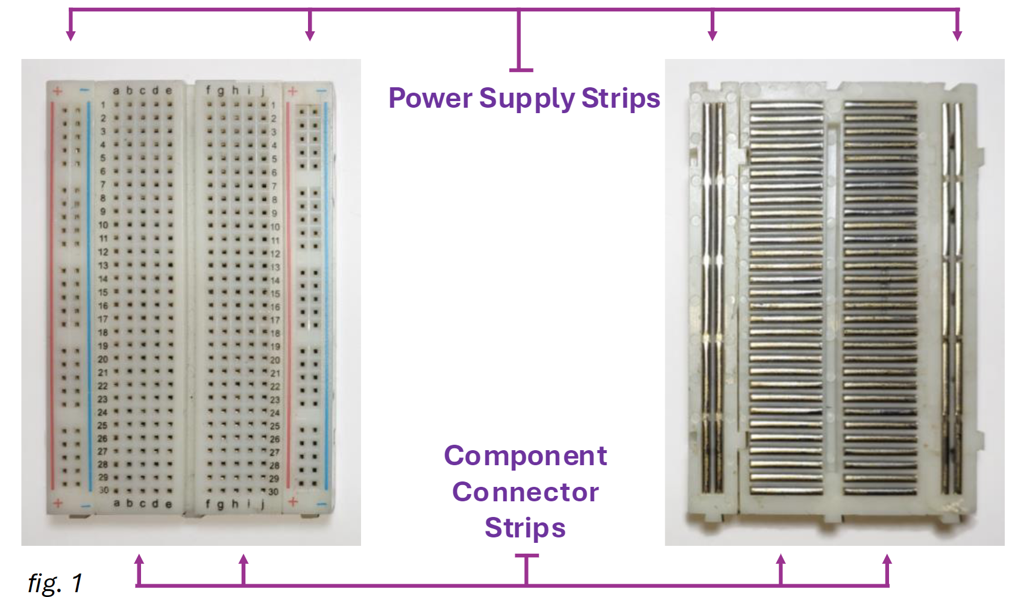
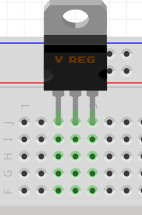
Fungi Kit Wiring Guide
Breadboard Connection Guide
To build your prototype you will be using a solderless breadboard.
Breadboards look like a grid of holes. Underneath the surface, metal strips connect the holes in a set pattern (fig. 1). Each row of 5 holes, called Component Connector Strips, is connected underneath. Power Supply strips run vertically along the sides.
If you plug both pins of a component into the same row, they become joined to the same connection — so no current flows. To make the circuit work, place each pin in a different row so electricity can pass through.
fig. 1
Note how the regulator’s pins in fig. 2 are lined up horizontally, fitting in rows 3, 4, 5 within row J.
We will use a jumper cable to connect the regulator later.
fig. 2

Slide 3
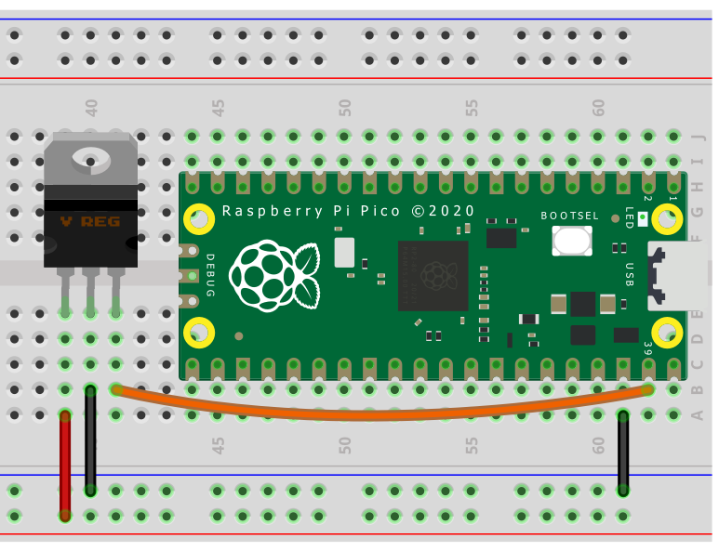
Fungi Kit Wiring Guide
Step 1: Installing Power Connections
In your kits you will have received a breadboard with a Raspberry Pi Pico and a 5V Voltage Regulator already inserted. You need to connect these as shown below (fig. 3)
A voltage regulator is a small electronic part that makes sure devices get a steady and safe amount of electricity. Different devices need different voltages to work properly. For example, the Raspberry Pi Pico needs between 1.8 and 5.5 volts to run safely.
If we connect a 9-volt battery straight to the Pico, it will give too much power and could damage the board. A 5-volt voltage regulator takes the 9 volts from the battery and reduces it to 5 volts. This way, the Pico gets the right amount of power to work properly without overheating or breaking.
fig. 3
Note: The cable colours don’t affect how the circuit works, but following the suggested colour scheme makes it easier to check your connections if you have the right cables available.

Slide 4
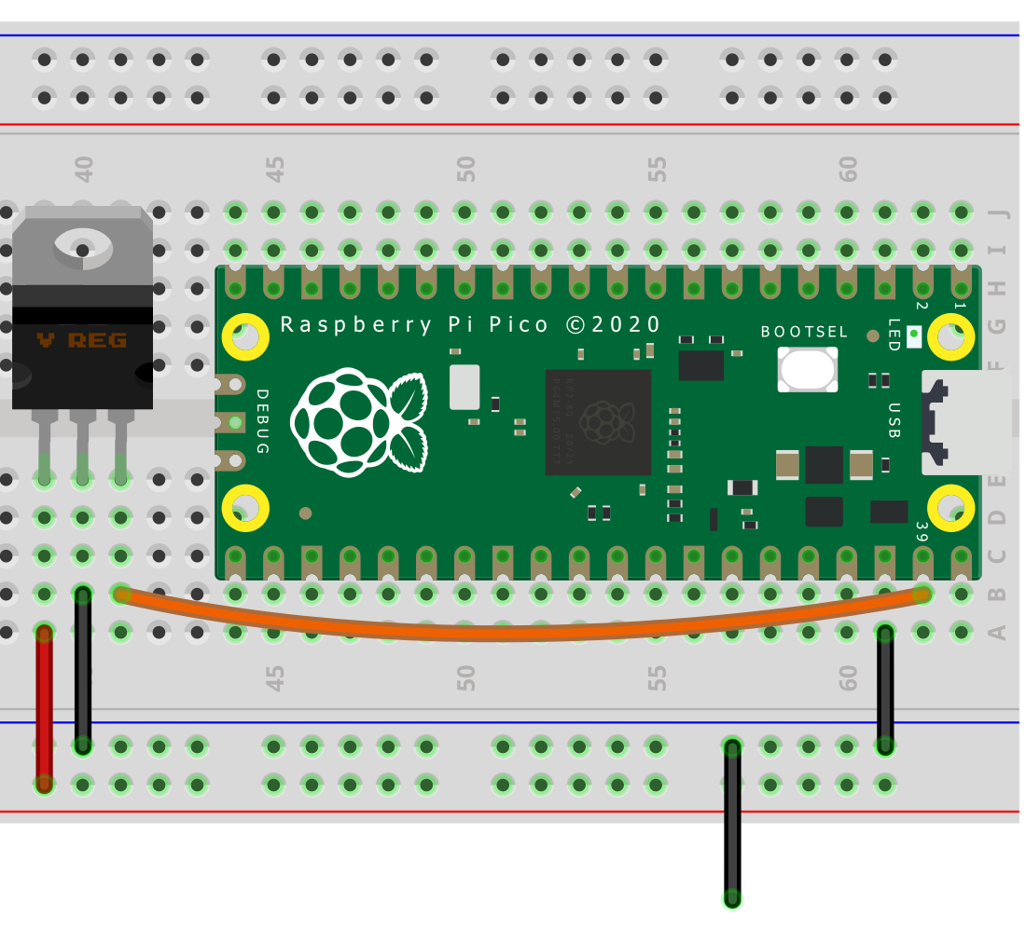
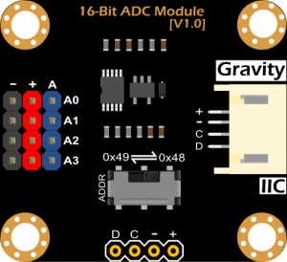
Fungi Kit Wiring Guide
Step 2: Connecting the Analogue-to-Digital Converter (ADC)
Connect the Red, Black, Green, and Blue wires from the analogue-to-digital converter (ADC) as shown below (fig. 4).
On the analogue-to-digital converter (ADC) connect four different coloured jumper cables to the A0, A1, A2, and A3 pins in the A column (the column of blue pins). Ignore the + and – columns.
An analogue to digital converter (ADC) changes real-world signals into numbers the Raspberry Pi Pico can understand. In this project, it’s used to measure the tiny electrical signals produced by fungi.
fig. 4

Slide 5
Fungi Kit Wiring Guide
Step 3: Circuit inspection
Now that you have finished wiring your circuit double check your work then ask one of the UQ staff to inspect your circuit.
Once your circuit passes inspection you will be given a download cable, and you can move on to the programming.

